Slide 1
Control of Communicable Diseases and IHR
Dr. Anjali Singh,
Assistant Professor, BJMC, Ahmedabad.

Slide 2
Principles of Communicable Disease control
A communicable disease may be defined as an illness that arises from transmission of an infectious agent or its toxic product from an infected person, animal, or reservoir to a susceptible host, either directly or indirectly through an intermediate plant or animal host, vector, or environment

Slide 3
Overview of Possible and Likely Diseases
Transmission | Disease Possible
Air- Borne | ARI
 | Measles
 | Meningitis
 | Pertussis
 | Tuberculosis
Faecal or Faecal Oral | Amoeba
 | Cholera
 | Diarrhea
 | Dysentery
 | Hepatitis
 | Typhoid
 | Parasites

Slide 4
Overview of Possible and Likely Diseases
Transmisssion | Diseases possible
STI | Syphilis
 | Chancroid
 | Gonorrhoea
 | Chlamydia
 | Trichomonas
 | Others(HIV)
Vector Borne | Malaria
 | Dengue
 | Chikunguniya
 | leptospirosis

Slide 5
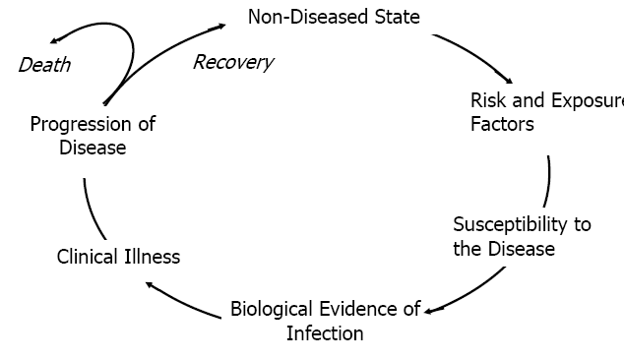
Communicable Disease Cycle

Slide 6
Basic Principles
Agent: Substance living or non living ,or a force tangible or intangible ,the excessive presence or relative lack of which may initiate or perpetuate a disease.
Host: A person who is susceptible to disease
Environment: All that is external to the individual human host, living and non living, and with which he is in constant interaction like air ,water, food housing etc

Slide 7
Principles of Communicable Disease control
Agent
Virulence
Infectious dose
Susceptibility to drugs
Mode of transmission
Host
Age
Genetic susceptibility
Nutritional status
Immunization status
General physical conditions
Environment
Shelter, altitude, Sanitation
food supply
water supply
Temperature
Overcrowding

Slide 8
Preventing communicable disease outbreak
Controlling the reservoir
Early diagnosis
Notification
Epidemiological investigation
Isolation
Treatment
Quarantine

Slide 9
Interruption of transmission
Chlorination of water
Hand washing
Adequate cooking
Prompt refrigeration of prepared food
Destruction of stray dogs
Early diagnosis and treatment
Personal hygiene
Proper handling of secretions and excretions

Slide 10
The susceptible host
Active immunization
Passive immunization
Combined active and passive immunization
Chemoprophylaxis
Community participation
Health education

Slide 11
Respiratory Infections
Acute Respiratory Illness (ARIs)
Provide shelter materials
Provide sufficient blankets
Tuberculosis
Train health workers on proper diagnosis, treatment, and follow-up of cases
Decrease crowding

Slide 12
Diarrhoeal Diseases
Build and keep latrines clean.
Chlorinate water and supply water vessels
Provide soap.
Promote food hygiene.
Health education on diarrhoeal disease control .

Slide 13
Malaria
Improve access to effective treatment.
Residual spraying of shelters and provide insecticide treated nets (ITNs) .
Give anti-malarial prophylaxis & intermittent treatment to pregnant women.
Manage/destroy potential vector breeding sites

Slide 14
Measles
Minimum living space standards (if possible).
Mass immunization campaign with vitamin A distribution to all children under 5.
Carry out a nutritional survey

Slide 15
Preventing outbreaks of communicable diseases
Hygienic disposal of Human faeces
Sufficient and safe water supply
Hand washing with soap
Health promotion
Food safety
Adequate living space
Adequate shelter
Nutrition
Medical interventions

